Slide 1

Application of proton activation analysis to determine the lithium content in samples.
A.Aleksanyan, S.Amirkhanyan, A.Aperyan, H. Gulkanyan, V.Ghavalyan, T. Kotanjyan, L. Poghosyan, A. Sahakov, A. Shahinyan
“A. I. Alikhanyan national science laboratory ( Yerevan Physics Institute ) ” (AANL)
“Neutron Physics and Radiation Materials” Conference, October 27–30, 2025, Yerevan

Slide 2
AANL installations for conducting scientific and applied research.
Cyclotron C-18 E_{p} = 18 MeV, I_{p}=1-30 mkA.
Linear electron accelerator (LINAC-75) E_{e} = 10 to 75 MeV, I_{e} = up to 1 mkA.
Low-background setup based on an HPGe GCD-20180 high-purity germanium detector․ The laboratory is located in the Avan salt mine at a depth of 650 meters of water equivalent.

Slide 3
The presence of a cyclotron, electron accelerator, and unique underground laboratory at the AANL allows not only to conduct research on rare nuclear processes but also to solve applied problems in the fields of ecology, medicine, geology, metallurgy, and mineral exploration.
It is especially important to note the presence of a low-background installation based on a lead-shielded HPGe detector in the AANL underground laboratory.

Slide 4
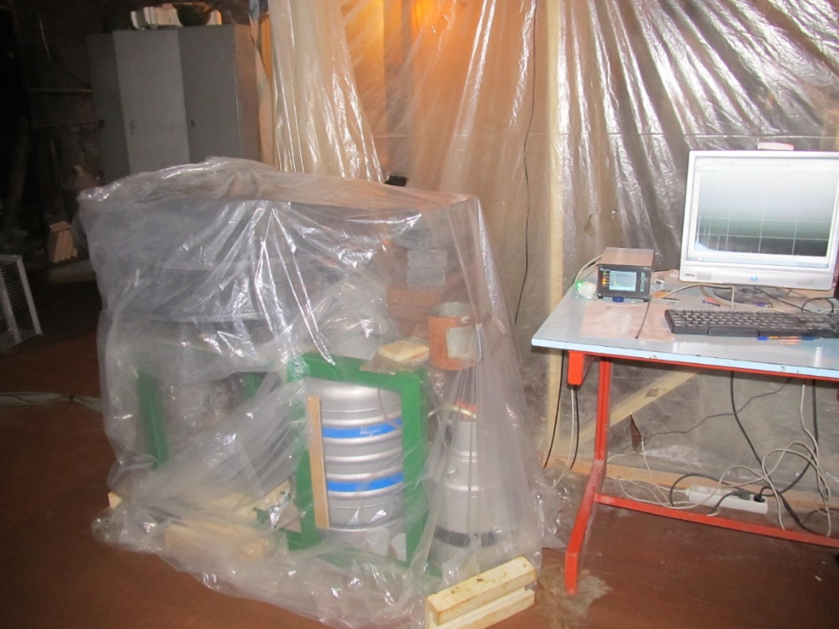

Slide 5
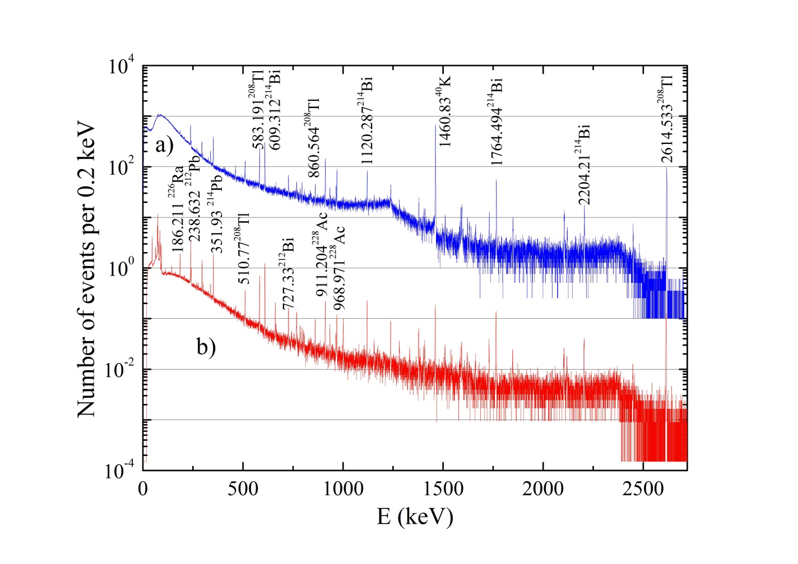
The number of background events registered by the HPGe detector within an hour (a) – in ground-based measurements, (b) – in underground measurements with protection.

Slide 6
The importance of rare and rare earth metals has increased dramatically. Therefore, determining the quantitative composition of these metals in rocks and processed waste is becoming increasingly important for responsible mining and processing methods.
The methods of proton activation and gamma activation analysis we use are aimed at determining the quantitative composition of such metals.

Slide 7
When targets from the studied sample are irradiated with protons or gamma quanta, daughter isotopes of the elements present in the sample are formed as a result of proton-nuclear and photonuclear reactions.
As a result of gamma-spectrometric analysis, based on the measured induced activity of characteristic γ-radiation, it is possible to determine the number of nuclei of the parent isotope present in the target and, thereby, the number of nuclei of the desired chemical element present in the target.

Slide 8
Studies have shown that proton activation and gamma activation analysis methods can simultaneously determine the quantitative composition of dozens of elements in a sample, while having different concentrations.
At the AANL linear electron accelerator, using bremsstrahlung photon beams, gamma-activation analysis (GAA) of geological obsidian samples was carried out for the first time in Armenia.

Slide 9
The results of the analysis of a number of chemical elements in an obsidian sample were shown to be comparable to the results of instrumental neutron activation analysis (INAA) of the same sample, conducted at the Center for Archaeometry Mainheim, Germany, after irradiation with neutrons in the specialized TRIGA nuclear reactor at the Institute of Nuclear Chemistry at the University of Mainz.
Using the GAA method, it is possible to obtain data on the content of elements (Ca, Ti, Mn, Sr, Y, Nb, Mo, Pb), for which the INAA method was ineffective.

Slide 10
Advantages of proton activation and gamma activation analysis methods.
Gamma-spectrometry analysis was carried out using a low-background setup based on an HPGe detector located in the AANL underground laboratory.
The setup provides high resolution and is protected by a shield made of high-purity lead and copper.
The energies of the characteristic gamma quanta accompanying the beta decays of daughter nuclei obtained as a result of irradiation are in a wide range (80 keV – 3000 keV)
A significant fraction of the daughter nuclei formed as a result of irradiation of the elements of interest have suitable and at the same time different half-lives Т_{½}.
The elements being studied have isotopes and, accordingly, as a result of various reactions (γ, n), (p, n), several daughter radioactive nuclei are formed.
Samples do not require pre-treatment.
Both methods complement each other.

Slide 11
This report is devoted to the possibility of determining the content of one of the rare metals, namely lithium (Li), in a sample using proton activation analysis.
Lithium's properties and characteristics, including its high energy density, low density, high electrochemical potential, and abundance in the Earth's crust, make it a critical element for a variety of industrial applications, particularly in batteries, electronics, automotive, and aerospace.

Slide 12
Schematic diagram of a target system for the quantitative determination of lithium (Li) content in a sample using a proton beam.
StSt
Airspace L=13 cm
Al
Cu
LiF
Cu
LiF
Cu
LiF
Cu
Grave
Cu
LiF
Cu
Proton energy E_{p} =18 MeV.
Proton beam current I_{p} = 1.0 mkA.
Irradiation time is 10 minutes.
StSt – duct window – stainless steel d=100 µm.
Airspace – air space L=13 cm,
Cu – monitor - copper foil d=25.4 µm
LiF – lithium fluoride
Grave – rock sample
Al – aluminum foil d=20 µm

Slide 13
Gamma spectrometric analysis was carried out using a low-background setup based on an HPGe detector located in the underground laboratory of the Avan salt mine.
As a result of spectrometric analysis, the yield Y (the number of nuclei of a given radioisotope formed as a result of irradiation per unit of time) of the radioisotope is determined.
where S is the area of the total absorption photopeak,
I_{γ} is the relative intensity of the γ-line,
ε_{γ} is the γ-ray detection efficiency,
λ is the decay constant of the given radioisotope,
t_{p} – is the irradiation time,
t_{c} – cooling time,
t_{R} and t_{L} are the real and live time of the γ-spectroscopic measurement

Slide 14
Copper targets were used to determine the proton beam current in different targets by measuring the yield of the monitor reaction ⁶⁵Cu(p,n)⁶⁵Zn

Slide 15
The data on the cross section σ_{m}(E_{p}) of the reaction ⁶⁵Cu(p,n)⁶⁵Zn recommended by the IAEA were used.
The energy spectra f_{p} (E_{p}) of protons incident on each target were calculated using the SRIM/TRIM and GEANT programs.
As a result of convolution of the given spectra, we obtain the cross section of the ⁶⁵Cu(p,n)⁶⁵Zn reaction for each monitor target.
σ _{mi} = ∫ σ_{m}(E_{p})·f(E_{p} )·dE_{p}

Slide 16
The yield values (Y_{mi}) and the corresponding cross-sections (σ_{mi}) of irradiated copper foils obtained as a result of gamma-spectroscopic analysis make it possible to estimate the proton beam current I _{pi} (i=1..6) in each copper foil.
I _{pi} = Y_{mi} / (ν_{mi} x σ _{mi} )
ν_{m} – surface density of target nuclei cm⁻²
N_{A} – Avogadro's constant, A_{m} – atomic mass, f_{m} - relative abundance of a given isotope

Slide 17
Estimation of the cross section of the ⁷Li(p,n)⁷Be reaction occurring as a result of irradiation in each LiF target.
Gamma-spectroscopic analysis of irradiated LiF samples identified the ⁷Be nucleus by detecting the accompanying beta decay, a characteristic gamma quantum with an energy of E_{γ} = 477.6 keV (I_{γ} = 10.44%). The reliability of the identification was verified by comparing the half-life of ⁷Be with the obtained value T_{1/2} = 54.2 ± 2.4 days.
For each LiF sample, the yield (Y_{mi}) of the radioisotope ⁷Be was calculated using gamma-spectroscopic analysis.
Using the values ​​of the proton beam currents passing through the copper foils, the cross sections of the ⁷Li(p,n)⁷Be reaction can be estimated for each LiF target.
σ _{LBi} = Y_{Bei} / (ν_{Lii} x I _{i} )

Slide 18
Parameters of experimental targets, characteristics of the proton beam, and results of measuring the cross section of the ⁷Li(p,n)⁷Be reaction.
 | Subtarget and Thickness or mass | <E_{p}> (MeV) | σ_{Li} (mb) ⁷Li(p,n)⁷Be | Y (in 10⁶/sec) | I_{p} (in µA)
1 | Cu1 d=25.4 µm, m= 0,0232g | 16.05±0.17 |  | 11.48±0.96 | 0.234±0.019
2 | LiF1 d=107 µm, m= 0,034g | 15.54±0.28 | 31.34±3.43 | 31.73±2.18 | 0.226±0.019
3 | Cu2 d=25.4 µm, m= 0,0225g | 14.50±0.19 |  | 17.61±1.75 | 0.216±0.021
4 | LiF2 d=119 µm, m= 0,034g | 13.96±0.31 | 36.78±4.07 | 33.81±2.49 | 0.201±0.019
5 | Cu3 d=25.4 µm, m= 0,0222g | 12.69±0.21 |  | 26.98±2.16 | 0.194±0.016
6 | LiF3 d=117 µm, m= 0,034g | 12.17±0.37 | 42.96±5.0 | 34. 25±2.58 | 0.181±0.017
7 | Cu 4 d=25.4 µm, m= 0,0232g | 10.78±0.44 |  | 34.73±2.83 | 0.171±0.012
8 | Gr m=0.0402g m_{Li in Qaj} =34.01±5.35mg/kg | 9.93±0.26 | 66.93±7.2 | (8.45±2.61)*10³ | 0.198±0.015
9 | Cu5 d=25.4 µm, m= 0,0205g | 7.28±0.30 |  | 32.56±2.37 | 0.287±0.026
10 | LiF4 d=125 µm, m= 0,0331g | 6.25±0.38 | 129.7±26.3 | 104.54±7.22 | 0.168±0.032

Slide 19
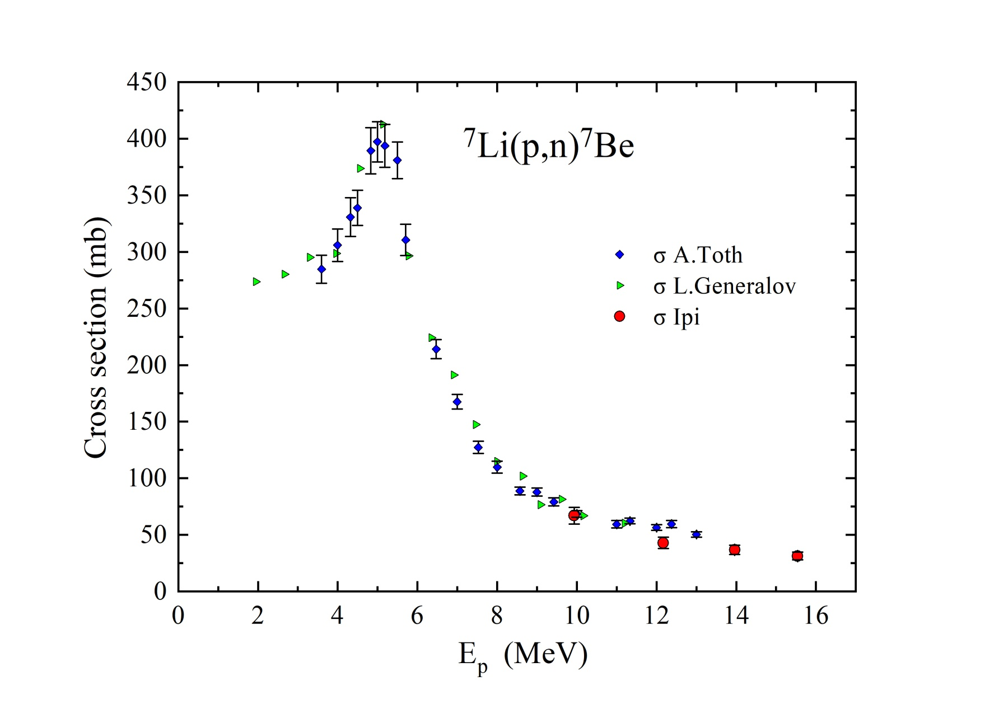
Cross section of reaction ⁷Li(p,n)⁷Be

Slide 20
Experimental results
The cross-section values ​​for the ⁷Li(p,n)⁷Be reaction in the region E_{p} = 8-15 MeV were obtained. The obtained values ​​were compared with data available in the literature.
The lithium (Li) content in the sample was calculated: m_{Li} = 34.01±5.35 mg/kg

Slide 21
Schematic diagram of a target system for the quantitative determination of lithium (Li) content in a salt ore sample using a proton beam.
StSt
Al
Cu
HH1
Cu
LiF
Cu
HH2
Cu
LiF
Cu
Proton energy E_{p} =18 MeV.
Proton beam current I_{p} = 1.0 mkA.
Irradiation time is 10 minutes.
StSt – duct window – stainless steel d=100 µm.
Airspace – air space L=13 cm,
Cu – monitor - copper foil d=25.4 µm
LiF – lithium fluoride
HH1, HH2 – salt ore samples
Al – aluminum foil d=20 µm

Slide 22
Parameters of experimental targets, characteristics of the proton beam, and results of measuring the cross section of the ⁷Li(p,n)⁷Be reaction.
 | Subtarget and Thickness or mass | <E_{p}> (MeV) | σ _{Li} (mb) | Y_{m} (in 10⁶/sec) | I_{p} in µA)
1 | Cu1 d=25.4 µm, m= 0,0389g | 16.07±0.25 | 152,68 | 14.09±0.96 | 0.223±0.016
2 | HH1 m= 0,209g | 15.54±0.26 |  |  | 0.197±0.029
3 | Cu2 d=25.4 µm, m= 0,0385g | 11.63±1.0 |  | 37.34±2.53 | 0.171±0.019
4 | LiF1 m= 0,058g m _{Li1} = 0.015 g | 10.80±0.84 | 68.06±7.2 | 61.74±3.93 | 0.168±0.014
5 | Cu3 d=25.4 µm, m= 0,0414g | 9.36±0.88 |  | 32.64±2.36 | 0.165±0.019
6 | HH2 m_{Li HH2} = 1.73x 10⁻⁵ g 100.6±12.6 mg/kg, m_{Li HH2} = 93.5±4.8 mg/kg, m _{Li HH2} = 112.6±9.7 mg/kg | 8.33±1.07 | 92.6±11.1 99.0±5.1 | 82751±6197 | 0.161±0.016
7 | Cu4 d=25.4 µm, m= 0,0443g | 7.48±1.20 |  | 12.85±0.91 | 0.157±0.021
8 | LiF2 m= 0,0413g m _{Li2} = 0.011 g | 7.14±0.88 | 103.2±17.4 | 45.67±2.53 | 0.125±0.019

Slide 23
The lithium (Li) content in the HH2 salt ore sample was calculated using three methods.
Express method
m _{Li HH2} = 112.6±9.7 mg/kg.
Using the above method
m _{Li HH2} =100.6±12.6 mg/kg.
Using the cross-section value from the literature m_{Li HH2} = 93.5±4.8 mg/kg.

Slide 24
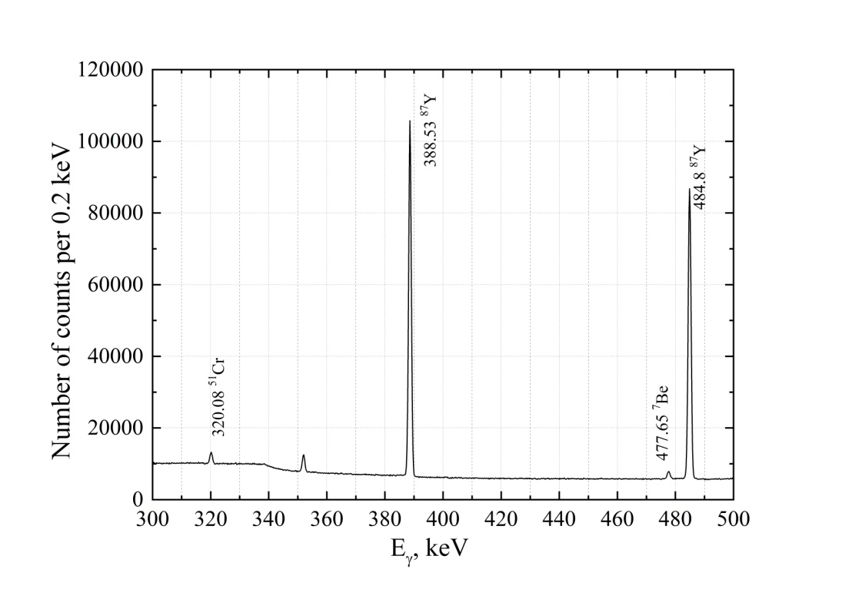
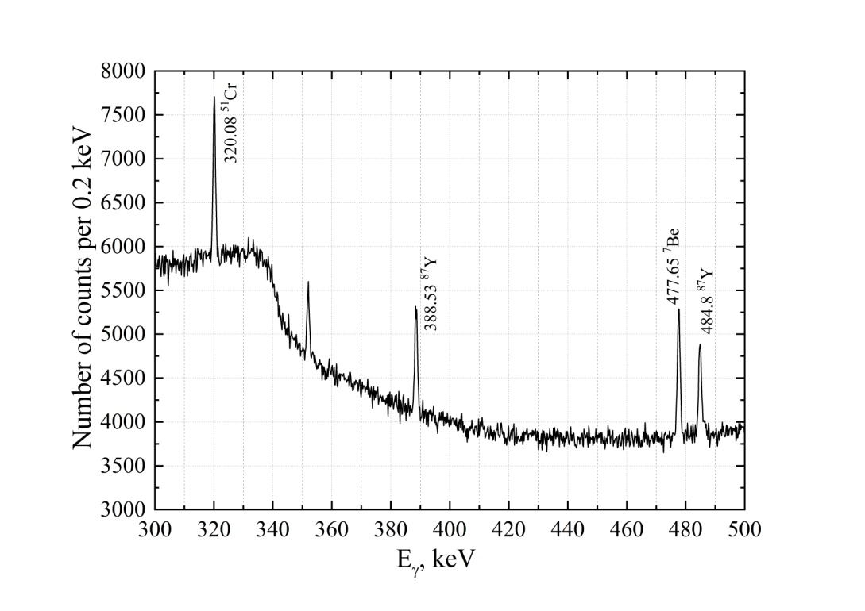
γ-spectra of sample HH2 after 8 and 29 days of irradiation, respectively.

Slide 25
Schematic diagram of the target system for determining the quantitative content of lithium (Li) in a reference sample of granite grade N42 MK-4 using a proton beam.
StSt
Airspace L=14cm
Al
Cu
N42
Cu
N42
Cu
N42
Cu
N42
Cu
N42
Cu
Proton energy E_{p} = 18 MeV
Proton beam current I_{p} = 1.1 mkA.
Irradiation time is 10 minutes.
StSt – duct window – stainless steel d=100 µm.
Airspace – air space L=14 cm,
Cu – monitor - copper foil d=25.4 µm
N42 – reference sample of granite grade N42 MK-4
Al – aluminum foil d=20 µm
The lithium content was calculated for granite sample N42-2
m _{Li N42-2} = 28.35 ±4.2 mg/kg

Slide 26
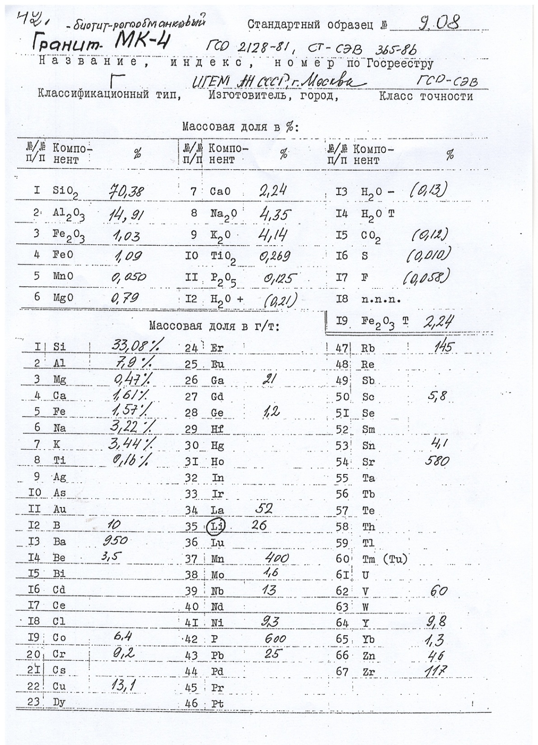

Slide 27
Conclusion
The lithium (Li) content of geological samples taken from a mine in southern Armenia and from the Avan salt mine (Yerevan) was determined to be 34.0 ± 5.3 mg/kg and 100.6 ± 12.6 mg/kg, respectively.
The reliability of the proton activation analysis method was verified by comparing the previously known lithium (Li) content in the reference sample of granite grade N42 MK-4 (26 mg/kg) with the value of 28.35 ±4.2 mg/kg measured in this work.

Slide 28
THANK YOU FOR YOUR ATTENTION

Slide 32
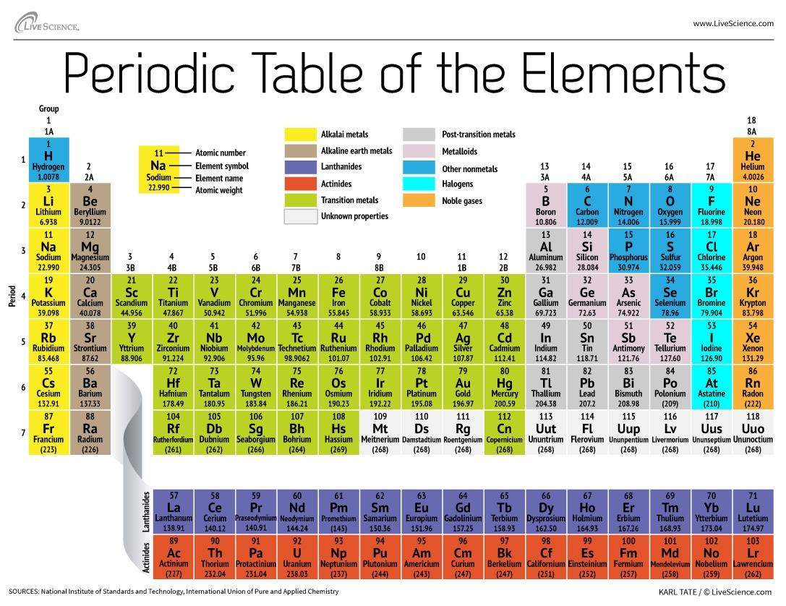

Slide 33
Some characteristics of (p,X) reactions for determining the content of precious and rare earth metals
Target-core | Isotope fraction of an element % | reaction under study | the daughter nucleus of the (p,X) reaction and its half-life | The energy (keV) and intensity of the γ-quantum accompanying (%) the fission of the daughter nucleus
¹⁹²Os | ^{40.78} | ¹⁹²Os(p,n)¹⁹²Ir | ¹⁹²Ir (73.829 օր) | 316.506(82.86%)
¹⁹⁰Os | ^{26.26} | ¹⁹⁰Os(p,n)¹⁹⁰Ir | ¹⁹⁰Ir (11.78 օր) | 605.14 (37.8%)
¹⁰³Rh | 100 | ¹⁰³Rh(p,d) ¹⁰²Rh | ¹⁰²Rh (207.3 օր) | 475.06 (46.0%)
¹⁰⁵Pd | 22.33 | ¹⁰⁵Pd(p,n) ¹⁰⁵Ag | ¹⁰⁵Ag (41.29 օր) | 344.61 (42.0%)
¹⁹⁷Au | 100 | ¹⁹⁷Au(p,n) ¹⁹⁷Hg | ¹⁹⁷Hg (23.8 ժամ) | 134(33%), 279.0(6%)
¹⁹⁶Pt | 25.21 | ¹⁹⁶Pt(p,n)¹⁹⁶Au | ¹⁹⁶Au (6.1669 օր) | 333.03 (22.9%) 355.73(87.0 %)
⁴⁵Sc | 100 | ⁴⁵Sc(p,p+n)⁴⁴Sc ⁴⁵Sc(p,p+n)^{44m}Sc | ⁴⁴Sc (4.042 ժամ) ^{44m}Sc (58.61 ժամ) | 1157.022(99.887%) 271.251(86.72%)
⁸⁹Y | 100 | ⁸⁹Y(p,n)⁸⁹Zr | ⁸⁹Zr (78.41 ժամ) | 909.15 (99.04%)
⁸⁹Y | 100 | ⁸⁹Y(p,2n)⁸⁸Zr | ⁸⁸Zr (83.4 օր) | 392.87 (97,29%)
¹³⁹La | 25.21 | ¹³⁹La(p,n)¹³⁹Ce | ¹³⁹Ce (137.64 օր) | 165.87 (79.9%)
¹⁴⁰Ce | 88.45 | ¹⁴⁰Ce(p,d)¹³⁹Ce | ¹³⁹Ce (137.64 օր) | 165.87 (79.9%)
¹⁴²Ce | 11.11 | ¹⁴²Ce(p,d)¹⁴¹Ce | ¹⁴¹Ce (32.504 օր) | 145.44 (48.3%)

Slide 34
¹⁴⁴Nd | 23.798 | ¹⁴⁴Nd(p,n)¹⁴⁴Pm | ¹⁴⁴Pm (363 օր) | 618.01 (98.0%)696.49(99.49%)
¹⁴⁸Nd | 5.756 | ¹⁴⁸Nd(p,n)¹⁴⁸Pm ¹⁴⁸Nd(p,n)¹⁴⁸Pm | ¹⁴⁸Pm (5.368 օր) ¹⁴⁸Pm (41.29 օր) | 550.27 (22.0%) 550.27(94.9%)629.97(89.0%)
¹⁴⁴Nd | 23.798 | ¹⁴⁴Nd(p,n)¹⁴⁴Pm | ¹⁴⁴Pm (363 օր) | 618.01 (98.0%)696.49(99.49%)
¹⁴⁷Sm | 15 | ¹⁴⁷Sm (p,n)¹⁴⁷Eu | ¹⁴⁷Eu (24.1 օր) | 197.299 (24.08%)677.52(9.8%)
¹⁵¹Eu | 47.81 | ¹⁵¹Eu (p,n)¹⁵¹Gd | ¹⁵¹Gd (124.5 օր) | 153.6 (6.2%) 243.29 (5.6%)
¹⁵⁶Gd | 20.47 | ¹⁵⁶Gd (p,n)¹⁵⁶Tb | ¹⁵⁶Tb (5.35 օր) | 534.29 (67%) 1222.44 (31%)
¹⁶⁸Er | 26.978 | ¹⁶⁸Er (p,n)¹⁶⁸Tm | ¹⁶⁸Tm(93.1 օր) | 198.25 (54.49%) 815.99 (50.95%)
¹⁶⁹Tm | 100 | ¹⁶⁹Tm(p,d)¹⁶⁸Tm | ¹⁶⁸Tm(93.1 օր) | 198.25 (54.49%) 815.99 (50.95%)
¹⁶⁹Tm | 100 | ¹⁶⁹Tm(p,n)¹⁶⁹Yb | ¹⁶⁹Yb (32.015օր) | 177.21 (22.28%)197.957(35.93%)
¹⁷²Yb | 26.978 | ¹⁷²Yb(p,n)¹⁷²Lu | ¹⁷²Lu (6.70օր) | 900.72 (29.8%)1093.63(63.0%)
¹⁷⁵Lu | 97.401 | ¹⁷⁵Lu (p, n)¹⁷⁵Hf | ¹⁷⁵Hf (70.67 օր) | 343.40 (84%)

Slide 35
Some characteristics of (γ,X) reactions for determining the content of precious and rare earth metals
Target-core | Isotope fraction of an element % | reaction under study | the daughter nucleus of the (γ,X) reaction and its half-life | The energy (keV) and intensity of the γ-quantum accompanying (%) the fission of the daughter nucleus
¹⁰³Rh | 100 | ¹⁰³Rh(γ,n) ¹⁰²Rh | ¹⁰²Rh (207.3 օր) | 475.06 (46.0%)
¹⁰⁶Pd | 27.33 | ¹⁰⁶Pd(γ,p) ¹⁰⁵Rh | ¹⁰⁵Rh (35.34 ժամ) | 319.23 (16.9%)
¹⁹⁷Au | 100 | ¹⁹⁷Au(γ,n) ¹⁹⁶Au | ¹⁹⁶Au (6.1669 d) | 355.68 (87%)
¹⁹⁸Pt | 7.356 | ¹⁹⁸Pt(γ,n) ¹⁹⁷Pt | ¹⁹⁷Pt (19.89 ժամ) | 191.437(3.7 %)
⁴⁵Sc | 100 | ⁴⁵Sc(γ,n)⁴⁴Sc ⁴⁵Sc(γ,n)^{44m}Sc | ⁴⁴Sc (4.042 ժամ) ^{44m}Sc (58.61 ժամ) | 1157.022(99.887%) 271.251(86.72%)
⁸⁹Y | 100 | ⁸⁹Y(γ,n)⁸⁸Y | ⁸⁸Y (106.627 օր) | 898.04 (93.7%) 1836.06 (93.7%)
⁸⁹Y | 100 | ⁸⁹Y(γ,2n)⁸⁷Y | ⁸⁷Y (79.8 ժամ) | 388.53 (82,2%) 484.805 (89,8%)
¹⁴⁰Ce | 88.45 | ¹⁴⁰Ce(γ,n)¹³⁹Ce | ¹³⁹Ce (137.64 օր) | 165.87 (79.9%)
¹⁴²Ce | 11.11 | ¹⁴²Ce(γ,n)¹⁴¹Ce | ¹⁴¹Ce (32.504 օր) | 145.44 (48.3%)

Slide 36
¹⁴⁰Ce | 88.45 | ¹⁴⁰Ce(γ,n)¹³⁹Ce | ¹³⁹Ce (137.64 օր) | 165.87 (79.9%)
¹⁴²Ce | 11.11 | ¹⁴²Ce(γ,n)¹⁴¹Ce | ¹⁴¹Ce (32.504 օր) | 145.44 (48.3%)
¹⁴⁸Nd | 5.756 | ¹⁴⁸Nd(γ,n)¹⁴⁷Nd | ¹⁴⁷Nd (11.12 օր) | 531.01 (13.11%)
¹⁶⁰Gd | 21.86 | ¹⁶⁰Gd(γ,n)¹⁵⁹Gd | ¹⁵⁹Gd (18.479 ժամ) | 363.54 (11.78%)
¹⁵⁹Tb | 100 | ¹⁵⁹Tb(γ,3n) ¹⁵⁶Tb | ¹⁵⁶Tb (5.35 օր) | 534.29 (67%) 1222.44 (31%)
¹⁶⁹Tm | 100 | ¹⁶⁹Tm(γ,n)¹⁶⁸Tm | ¹⁶⁸Tm(93.1 օր) | 198.25 (54.49%) 815.99(50.95%)
¹⁷⁶Yb | 12.996 | ¹⁷⁶Yb(γ,n) ¹⁷⁵Yb | ¹⁷⁵Yb(4.185 օր) | 396.329 (13.2%)
¹⁷⁵Lu | 97.401 | ¹⁷⁵Lu(γ,3n)¹⁷²Lu | ¹⁷²Lu (6.702 օր) | 900.724 (29.8%) 1093.63 (63%)

Slide 37
Elements | Relative content of an element (µg/g or %) measured by the GAA method | Relative content of an element (µg/g or %) measured by the INAA method
Na (%) | 2.52±0.33 | 3.22
K (%) | 3.79±0.35 | 3.40
Ca (%) | 0.445± 0.043 | Нет данных
Sc | 3.2 ±0.6 | 2.50
Ti (%) | 0.070±0.004 | Нет данных
Cr | 3.5 ±2.7 | 6.00
Mn | 404±29 | Нет данных
Fe (%) | 0.58±0.06 | 0.61
Co | 1.59±0.60 | 1.09
Zn | 47.8±15.5 | 40.0
As | 2.53 ±0.36 | 5.10
Rb | 128±8 | 135
Sr | 32.3±2.7 | Нет данных
Y | 26.3±1.9 | Нет данных
Zr | 72.2±5.1 | 73
Nb | 32.7±2.1 | Нет данных
Mo | 6.1±1.0 | Нет данных
Sb | 1.0±0.3 | 0.16
Cs | 3.57±0.24 | 3.64
Ва | 405±48 | 388

Slide 38
Се | 48.6±6.6 | 40.4
Nd | Нет данных | 17.0
Sm | Нет данных | 3.42
Eu | Нет данных | 0.369
Tb | Нет данных | 0.57
Yb | Нет данных | 2.44
Lu | Нет данных | 0.480
Hf | Нет данных | 3.45
Ta | Нет данных | 1.97
Pb | 16.1±2.8 | Нет данных
Th | 20.4±2.4 | 16.3
U | 5.74±0.45 | 6.20

Slide 39
Apple-ում օգտագործվում են
Gd
Y
Dy
Eu
La
Nd
Pr
Tb
Ce

Slide 40
Sc, Dy, Gd, Tb, Lu, Sm, Y - արգելք

Slide 41
Ծանր մետաղների և մետալոիդների դասակարգումը 3 վտանգի դասերի
Վտանգի դաս | ГОСТ 17.4.02.-83 Ռուսաստան | RIVM Report Netherlands
Հատկապես թունավոր | As Cd Hg Se Pb Zn | Be Se Tl Sb Cd
Թունավոր | Co Ni Mo Cu Sb Cr | V Hg Ni Cu Cr As Ba
Ցածր թունավորության | Ba V W Mn Sr | Zn Co Sn Ce Pb Mo

Slide 42
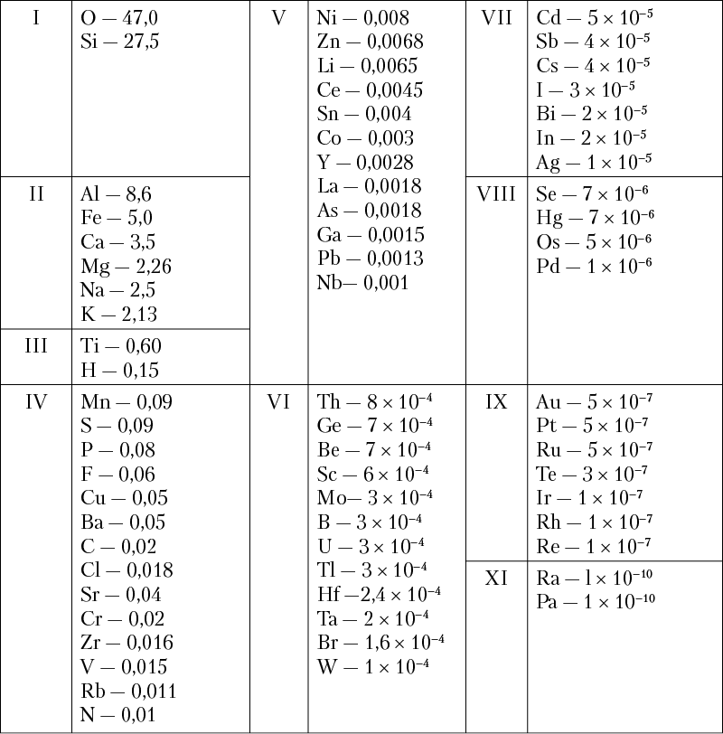

Slide 43
Տարր | Տարրի տարածվածությունն ըստmզանգվածի -% կամ մկգ/գ | Տարրի տարածվածությունն օբսիդիանում ըստ զանգվածի -% մկգ/գ | Տարրի տարածվածությունն գռանոդիարիտ ըստ զանգվածի -% մկգ/գ | SRM 278 INAA
O | 49.13
Si | 27.5 |  | 30.3 | 36.6
Al | 7.45 |  | 8.8 | 7.8
Fe | 4.2 | 0.58±0.06 | 3.25 | 1.32
Ca | 3.2 | 0.445± 0.043 | 2.75 | 0.60
Na | 2.4 | 2.52±0.33 | 3.16
K | 2.35 | 3.79±0.35 | 2.59 | 3.44
Ti | 0.61 | 0.070±0.004 | 0.38
Mn | 1000 | 404±29 |  | 430
Ba | 500 | 405±48 | 970 | 1072
Sr | 360 | 32.3±2.7 | 500
Rb | 110 | 128±8 | 121 | 129.3
Y | 28 | 26.3±1.9 | 25
Zr | 16 | 72.2±5.1 | 230 | 208
Nb | 10 | 32.7±2.1 | 15

